Slide 1
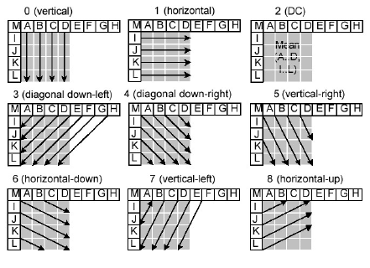
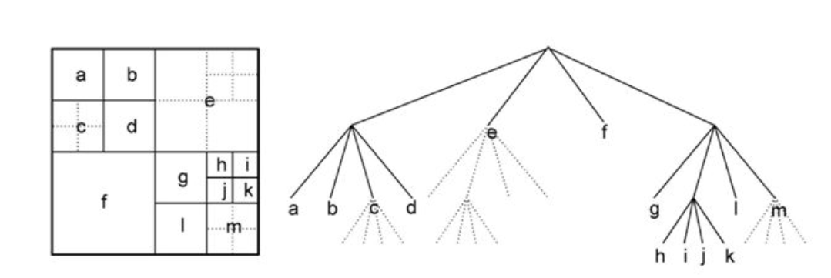
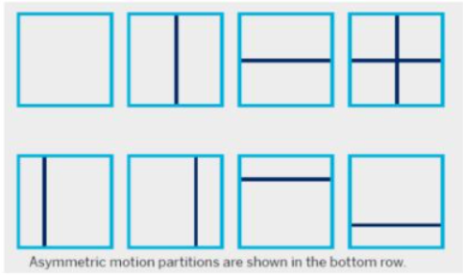
High Efficiency Video Coding (HEVC)
Poster Presentation
Aarya Tiwari , Dhairya Satra , Aditya Awhad
Introduction
Prediction Techniques
Coding Tree
HEVC (High-Efficiency Video Coding) is a video compression standard that was developed to provide better compression efficiency compared to previous video compression standards such as H.264/MPEG-4 AVC.
HEVC is commonly used for streaming video, video on demand (VOD), and other video applications where bandwidth and storage space are limited. It is also supported by popular devices and platforms such as iOS, Android, Windows, and macOS.
In HEVC (High-Efficiency Video Coding), there are two types of prediction modes used for compressing video data: intra prediction and inter prediction.
1. Intra prediction is used to predict the value of a pixel within a block using the values of other pixels within the same block.
the Coding Tree Unit (CTU) is the basic coding unit used for compression. The CTU is a rectangular block of pixels that is subdivided into smaller rectangular blocks called coding units (CUs). The size of the CTU is typically 64x64 or 128x128 pixels, and the size of the CUs can range from 8x8 to 64x64 pixels.
Why HEVC??
The main objective of HEVC is to achieve a significant reduction in the bit rate required for high-quality video while maintaining the same level of visual quality.
1. Larger block sizes: HEVC supports block sizes up to 64x64 pixels, which is four times larger than the maximum block size of 16x16 pixels supported by H.264.
2. Improved motion compensation: HEVC uses more accurate motion estimation and compensation techniques to predict the movement of objects in a video.
3. More efficient coding of prediction residuals: HEVC uses a more sophisticated approach to code the difference between the original video and the predicted video.
4. Flexible partitioning: HEVC allows for more flexible partitioning of the video into coding units, allowing for better adaptation to different video content types and resolutions.
Coding Units
2. Inter prediction, on the other hand, is used to predict the value of a pixel in a current block using the values of pixels from previously encoded frames or blocks.
CTB (Coding Tree Block): CTB is the largest coding unit in HEVC, and it is a rectangular block of pixels that is typically 64x64 or 128x128 pixels in size.
CTU(Coding Tree Unit) : CTU is a rectangular block of pixels that is typically 16x16 pixels in size, and it is the second highest level of the Coding
CB (Coding Block) : CB is a rectangular block of pixels that is typically 16x16 pixels in size, and it is used for intra-prediction in HEVC. The CB is further divided into smaller CUs, which can range in size from 8x8 to 16x16 pixels.
CU (Coding Unit): CU is the smallest coding unit in HEVC, and it is a rectangular block of pixels that is typically 8x8 or 16x16 pixels in size.

